Slide 1
CGB1201 – JAVA PROGRAMMING
Department of Artificial Intelligence and Data Science
Academic Year: 2024 – 2025 (Odd Semester)
Register Number : 2303811724321119
Name : Vaithyanadhan S G
Year : II Year
Semester : III
Section : B
Date : 25-11-2024

Slide 2
Project Title
HelpDesk Management System

Slide 3
Problem Identification
Prioritizing Issues The system automatically assigns priority to tickets based on the issue, ensuring critical problems are addressed first.
Admin Overload The system helps admins manage and assign tickets efficiently, reducing their workload.
Disorganized Ticket Management The system centralizes all tickets in one place for easy tracking and management.

Slide 4
Objective
User to:
Register, login, Add the ticket and View ticket.
Add ticket as there particular issues.
Admin to:
Register, log in and View all ticket .
Enable admins to view and manage all submitted tickets.
The system will provide essential functions for:
The admin can manage and review tickets efficiently.
Set priority based on keywords of descripsion.

Slide 5
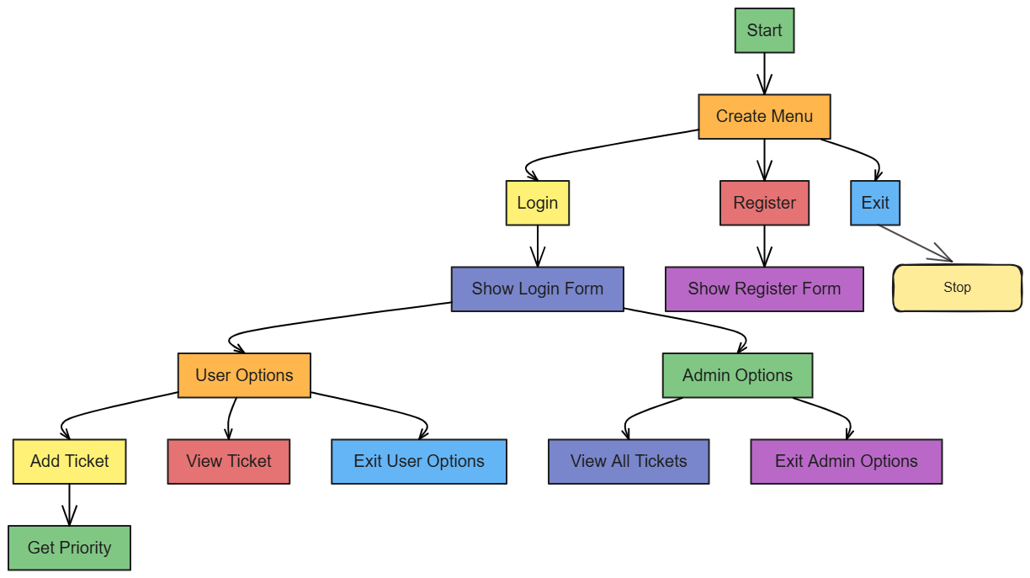
Proposed Architecture

Slide 6
Java Programming - Concepts Used
Java Swing for GUI: Create the graphical user interface.
Encapsulation: Specific functionalities in private for security.
(Hashmap) – Stores user credentials and ticket details.
Event Handling: Listens to and processes user actions such as button clicks using ActionListener.
Priority Management: Assigns predefined priority levels to tickets based on the issue type.

Slide 7
List of Modules
User Module:
Registration
Login
Adding ticket
View ticket
Admin Module:
Registration
Login
View ticket (as priority)

Slide 8
List of Modules
System Module:
Main menu navigation(GUI Interface)
Provides utility functions (determining ticket priority).

Slide 9
Module Description
User Module
Registration: Create an account with personal details,name, and password .
Login: Secure access using name and password.
Add Ticket: Add ticket and set ticket issue.
View Ticket: View the ticket registered.

Slide 10
Module Description (Cont..)
Admin Module
Registration: Register with personal details, name, and password.
Login: Secure access to name and password.
View Ticket: View all registered ticket.

Slide 11
Module Description (Cont..)
System Module
Main Menu Navigation: Menu-driven GUI interface for user options.
Data Storage: Efficiently stores and retrieves user ticket using Java collections.
Integration: Admin and User modules for seamless functionality.

Slide 12
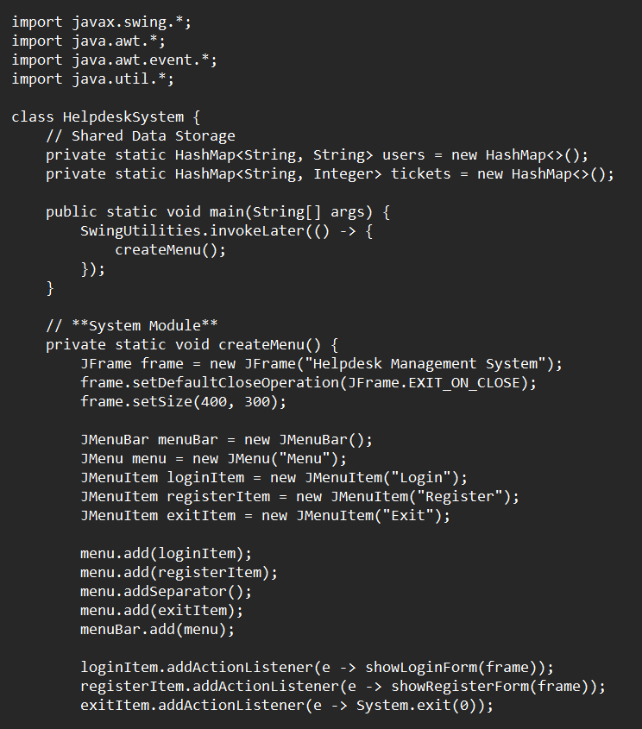
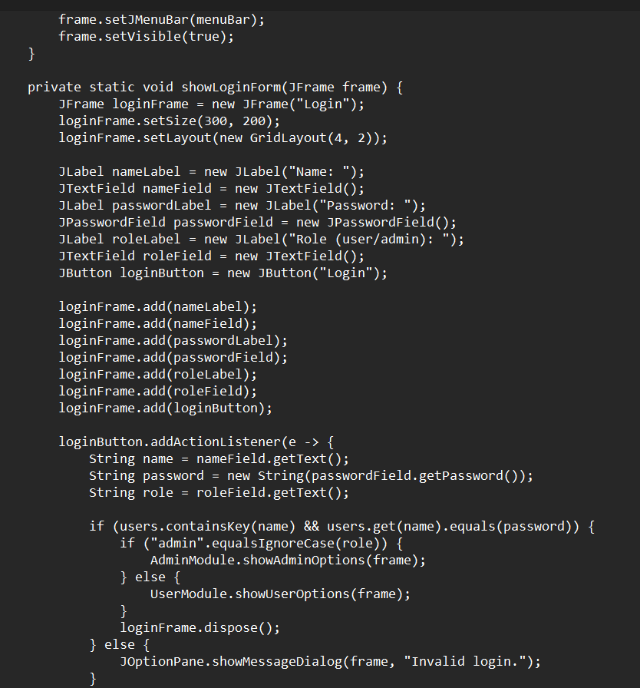
Source Code

Slide 13
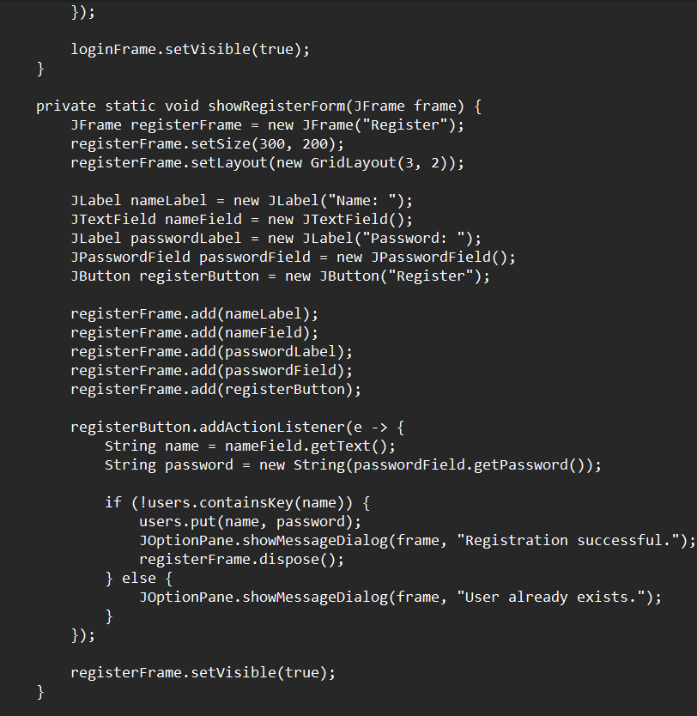
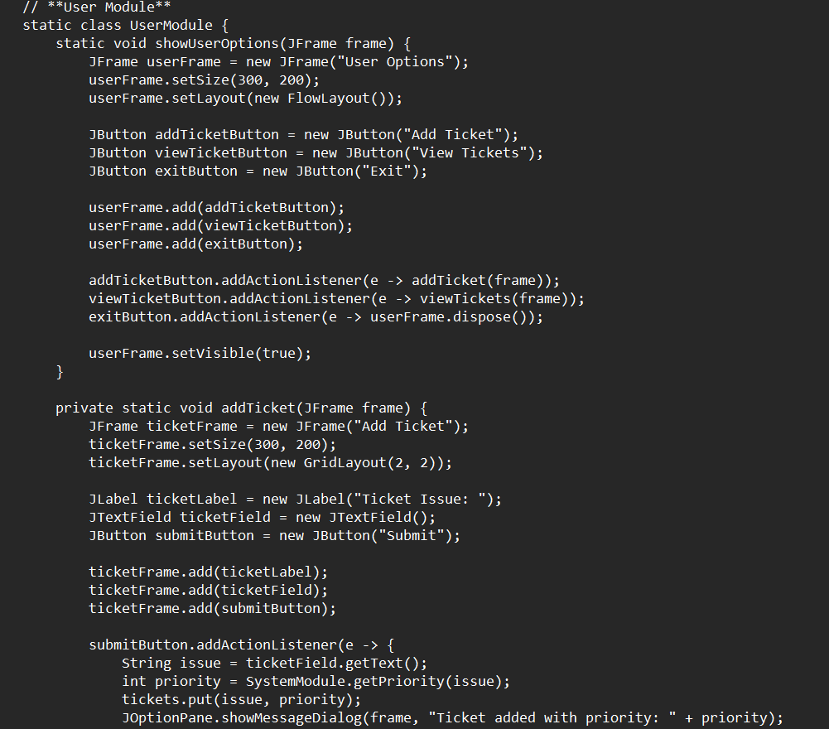
Source Code

Slide 14
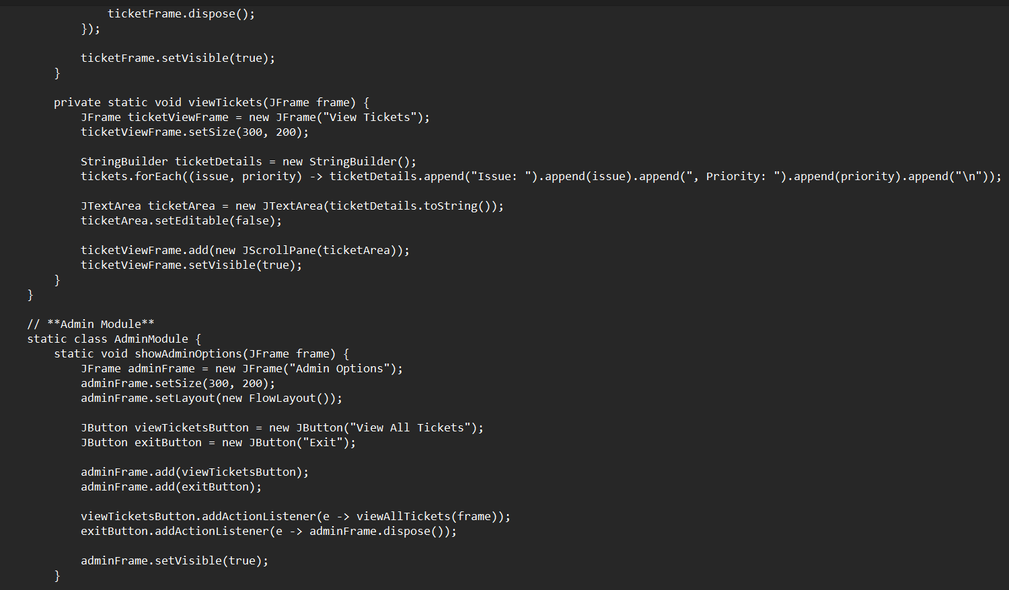
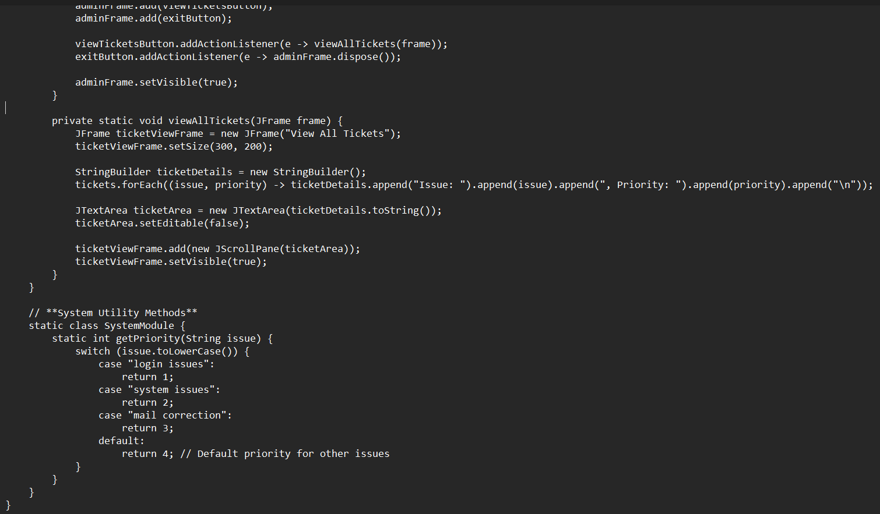
Source Code

Slide 15
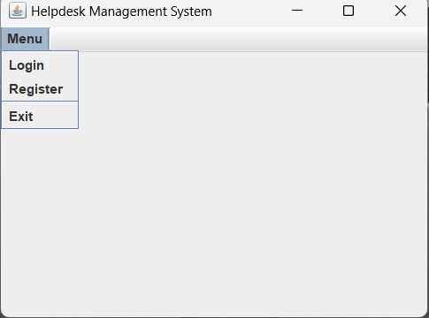
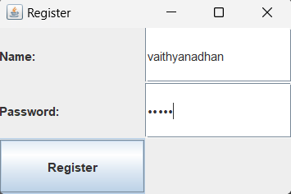
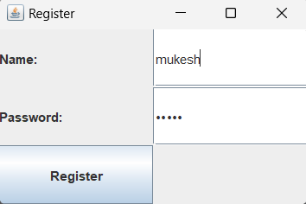
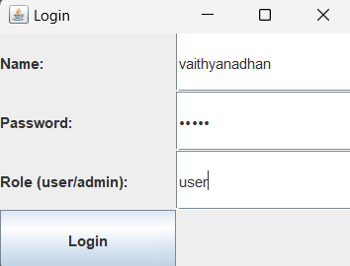
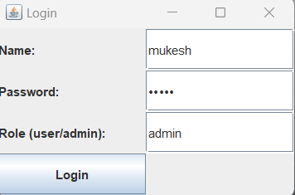
Results

Slide 16
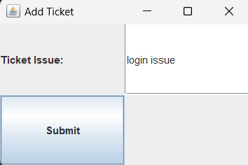
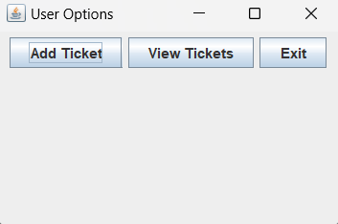
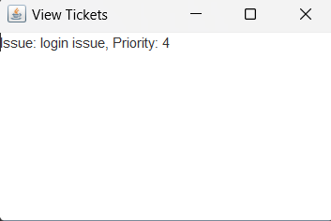
Results
User Login:

Slide 17
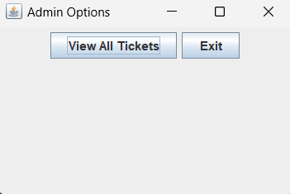
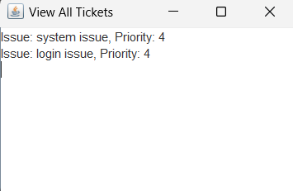
Results
Admin Login:

Slide 18
Conclusion
The Helpdesk Management System allows users to submit and view tickets, while admins can manage and prioritize all tickets. It provides a simple interface for efficient ticket management using Java Swing.

Slide 19
Thank You
ANY QUERIES???

